Slide 1

International Real Estate Agents- How can we help you choose your next hometown?
A case study presented as part of the IBM Captsone Final Project:
The Battle of the Neighborhoods
Ljiljana Nikolajev
Image taken from : https://www.glenerininn.com/travelling-smart-tips-for-travel/

Slide 2

Problematic
Moving from one country to another is not an easy task, particularly when one does not have a point of reference.
Finding the right neighbourhood for the right family is an essential part of international real estate agents’ job.
International real estate agents (IREAs) use tools, research and technology to ensure that their immigrating clients are matched with neighborhoods that are most appropriate for they lifestyle and more adapted to they needs.
In this case study, we will explore the step process that led IREAs to determine the best neighborhood for a family of France that moved from Paris, France, to Toronto, Ontario. The clients were looking for:
The safest neighborhood possible – or at least safer than their previous hometown
10km proximity to their future workplace – Michael Garron Hospital
Elementary and High School presence and proximity
Grea diversity in restaurant options

Slide 3
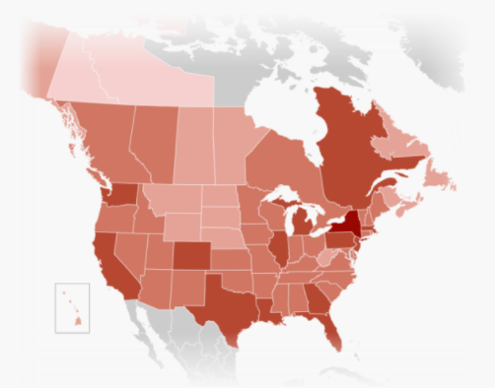
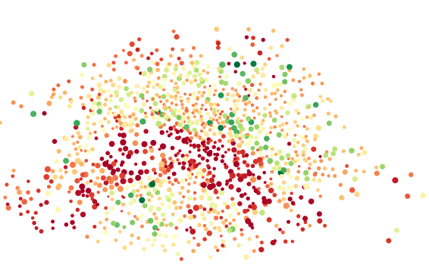

Solution and deliverables
Solution
Assess criminality with openly available data sources
Utilization of software, cloud-based technologies and APIs to explore characteristics and life scene life of Toronto, where the client will be immigration
Deliverables
A full report of the findings with
Visuals, including maps
Analytics
Recommendations

Slide 4
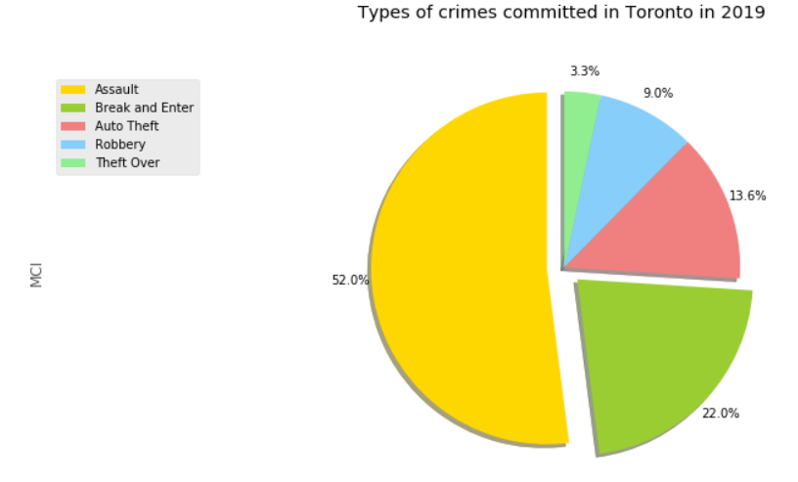
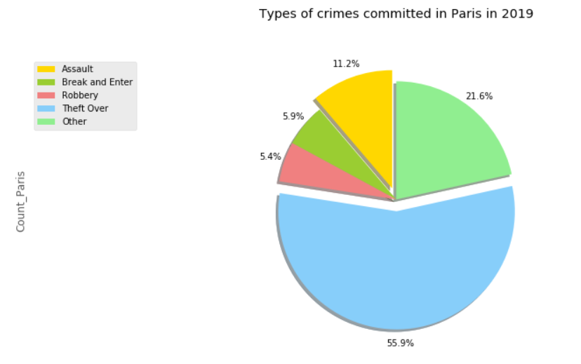
Analysis – Toronto is generally safer than Paris
In 2019, there were 37,624 crimes committed in Toronto (+ GTA), for an average of 13.9 crimes per millions of habitant
In 2019, there were 234,211 crimes committed in Paris (+ metro area), for an average of 23.0 crimes per millions of habitant

Slide 5
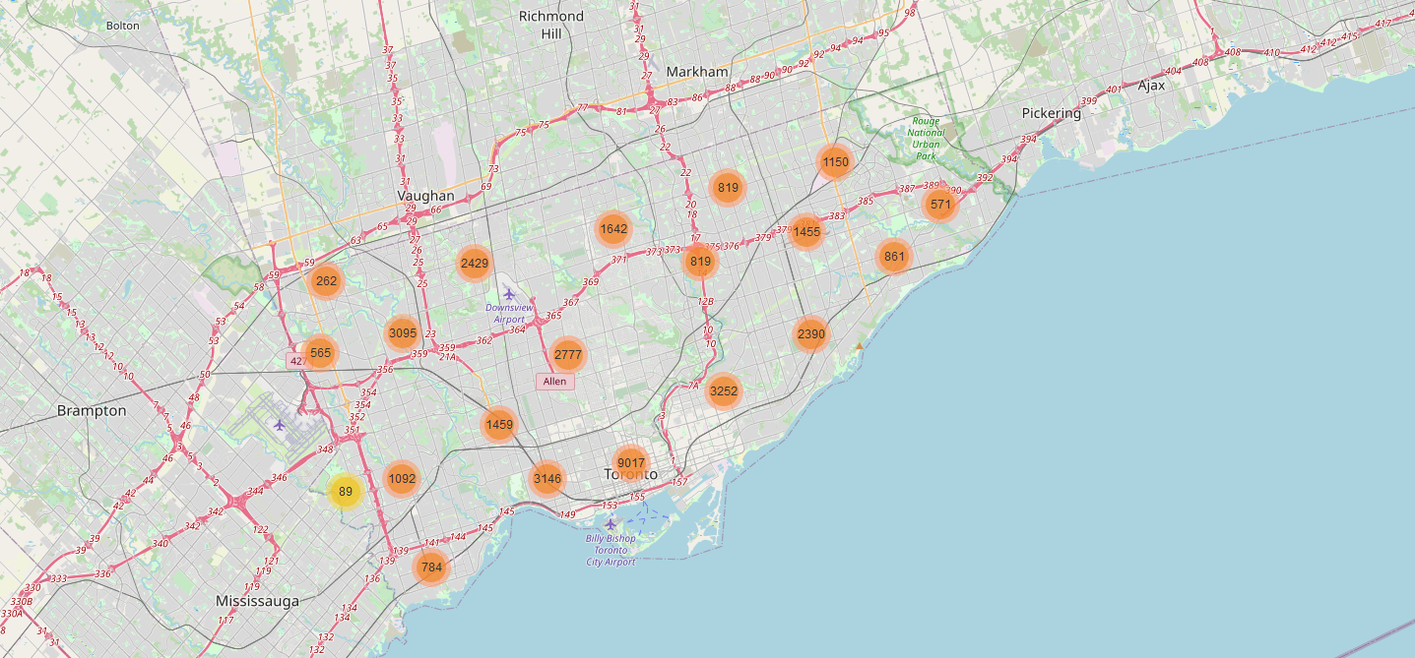
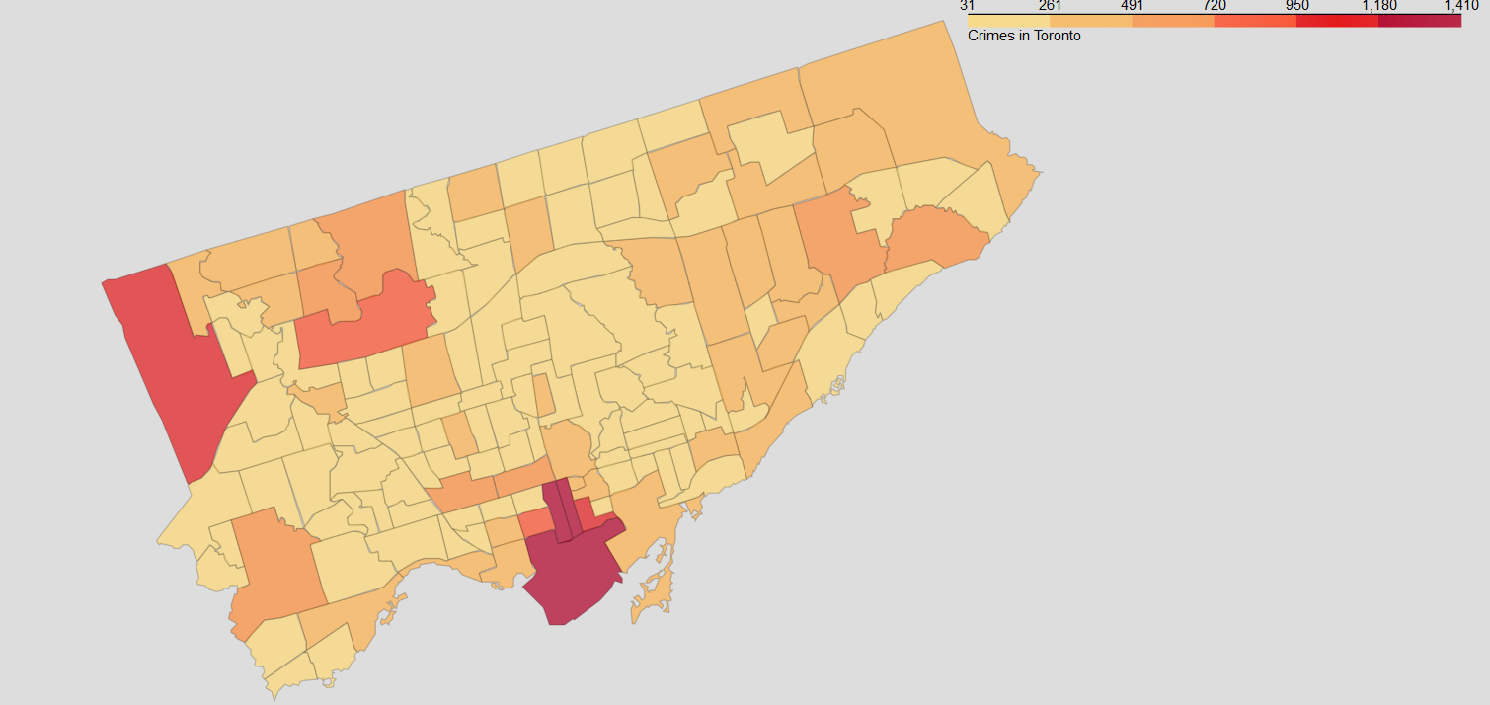
Analysis – Some neighborhood are safer than others
As illustrated on the map, crimes there are regions (in red), in which crimes most frequently occurs.
There are however 140 neighborhoods in Toronto. Further analysis is need to quantify and determine which neighborhood are the safest.

Slide 6
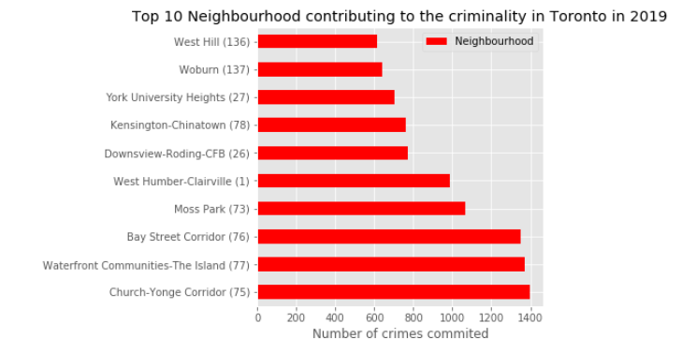
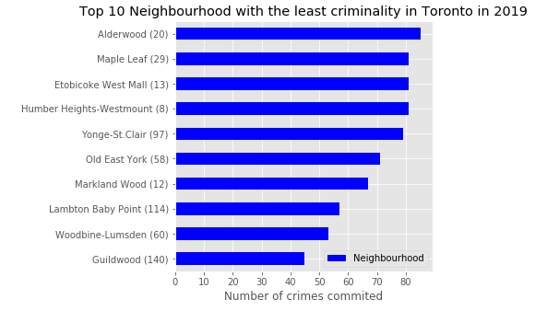
Analysis – 11 neighborhoods were considered for further analysis
Triaging our data, we can extract which neighbors are the most dangerous and which are the safest.
Since the clients wish to live in the safest neighbourhood, only the 10 safest will be considered for further review.
To be noted that 10th and 11th safest neighbourhood had the same level of criminality. 11thneighborhood was included in the following analysis.
All were residential, family oriented neighborhood and were therefore considered for further analysis

Slide 7
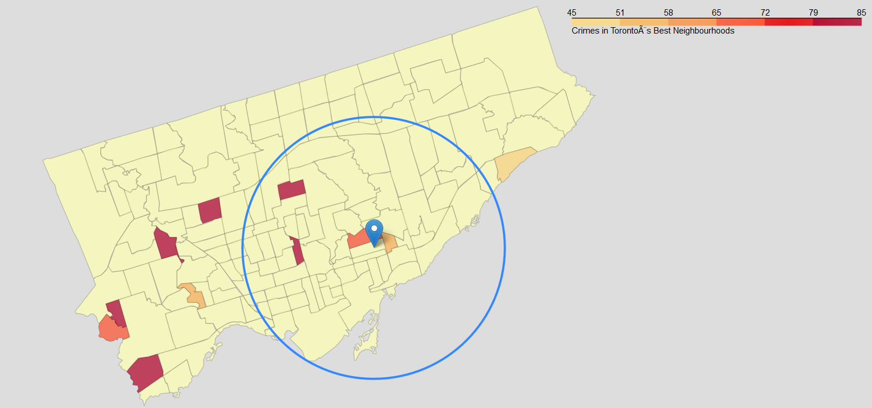
Analysis – Only four neighborhoods are within a 10km distance from the clients’ new workplace
Because the client has requested to live within 10km distance from they workplace, as to minimize commune, the 10 safest neighborhood were transposed on a map, and a delimiter was applied to narrow down the search.
The four neighborhoods that will be further considered for evaluations are:
Yonge-St-Clair
Old East York
Woodbine-Lumsden
Lawrence Parc North

Slide 8
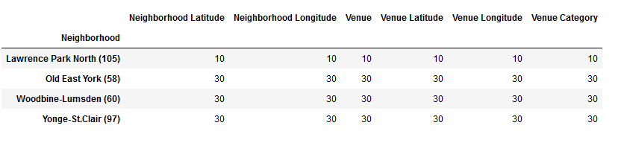
Analysis – Only 3 neighborhoods had enough venue to satisfy with the desire to leave in a neighborhood with a diverse dinner scene presence
Because the clients like to go out and discover new restaurant, while staying close to home, Lawrence Park North did not fit the criteria of being lively enough.
The three neighborhoods that will be further considered for evaluations are:
Yonge-St-Clair
Old East York
Woodbine-Lumsden
Lawrence Parc North

Slide 9
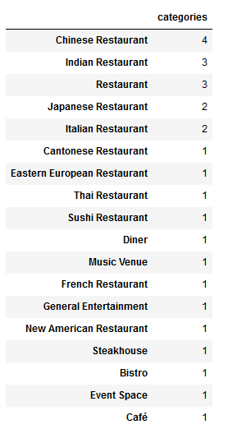
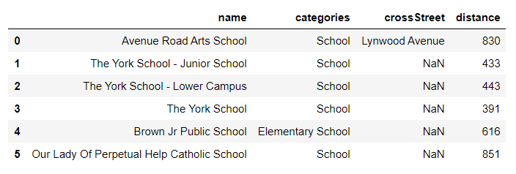
Analysis – Young St- Claire
27 restaurants within 2km radius with great food type variety
6 elementary and high school venues

Slide 10
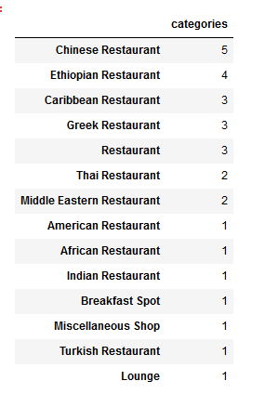
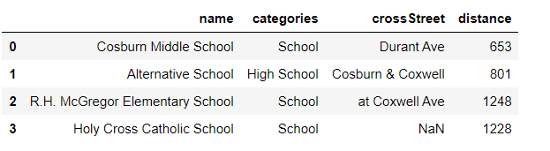
Analysis – Old East York
27 restaurants within 2km radius with great food type variety
4 elementary and high school venues

Slide 11
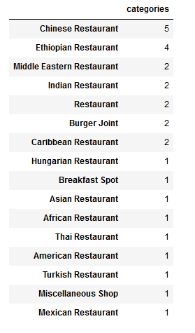
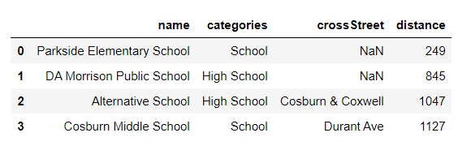
Analysis – Woodbine-Lumsden
27 restaurants within 2km radius with great food type variety
4 elementary and high school venues

Slide 12
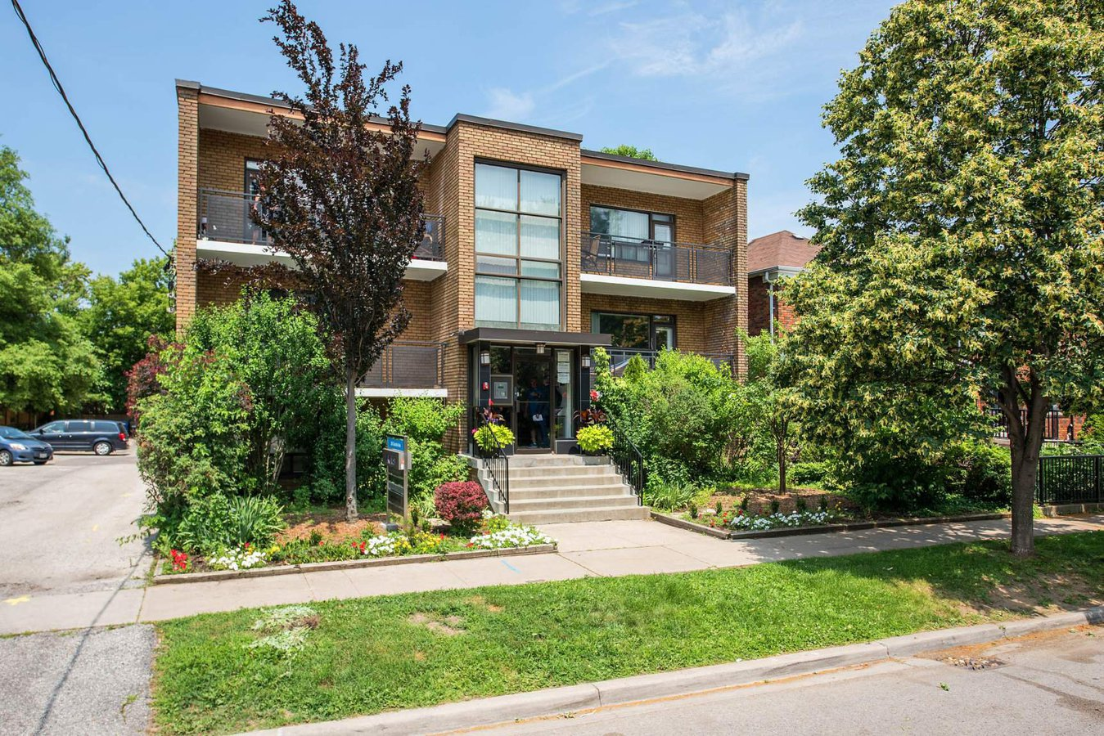
Conclusion and Recommendations
Yonge-St-Clair, Old East York & Woodbine-Lumsden all fit the customer profile.
Given that Old east York and Woodbine-Lumsden are geographically close and have better (and more) restaurant venues (although here is some overlap between the list), we think the client should focus their research in this region of Toronto.
This case study illustrates how IREAs can help clients find the neighborhood of their dreams, without having visited the place first.
This case study is a great example of what one can achieve when using technologies and techniques to analyse datasets.

